Slide 1
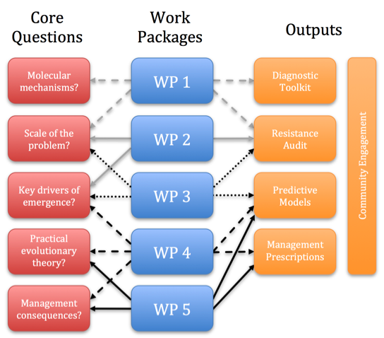

Slide 3
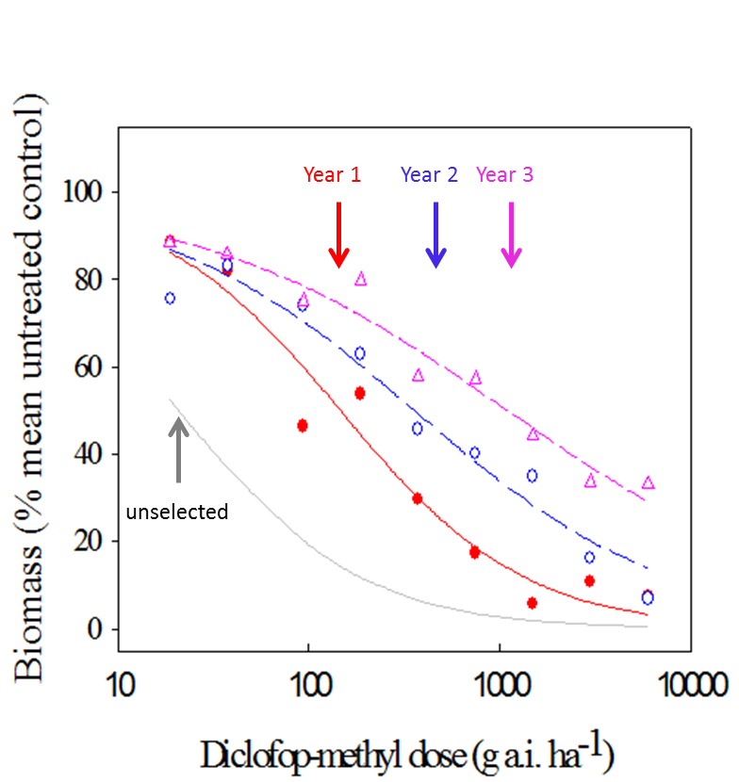

Slide 5
growth
kernel
survival
function
fecundity
function
recruit size
distribution
PLANT
TRAITS
Recruits
NEW SEASON
Plants (Growing Season )
Seeds Post Flowering
Seeds Post Germination
SEED AGEING TRANSITION
d₁: mortality (growing season); d₂: mortality (between season);
g: germination fraction; p_{e}: establishment probability
SEED
TRAITS

Slide 6
Land-use/management changes on study farms
Scenarios
Impact Analyses
Environment
Biodiversity
GHGs
Water quality
Farm economics
Herbicide resistance
Risk identification and response options

